Slide 1
Introduction to Bonding

Slide 2

Welcome to this Smart Lesson about atomic structure and bonding. After you have completed this lesson, you should be able to:
Describe the structure of an atom, including electron shells.
Explain how the filling of valence shells influences an atom’s stability.
Identify how atoms bond to attain full valence shells and achieve stability.

Slide 3
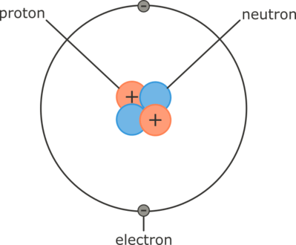
Atomic Structure
Atoms are made up of subatomic particles: positively charged protons (+1), negatively charged electrons (−1), and neutral neutrons (0). Atoms have the same numbers of protons and electrons, so overall they carry no charge.
Protons and neutrons pack together closely in the nucleus of an atom. Electrons are found in shells or orbitals around the nucleus. The opposite charges of the protons and electrons attract, and it is this attraction that holds the electrons orbiting around the nucleus.

Slide 4

Atoms are so small they can only be seen with extremely powerful microscopes.
The sizes of atoms are often measured in ångströms, where 1A˚=1×10⁻¹⁰ m. Protons and neutrons each have a mass of 1.67×10⁻²⁴ g. As this is such a small number, we often define it as the atomic mass unit (AMU). Electrons are much smaller, at 0.000549 AMU, or 1/1840 the mass of a proton or neutron.
Because of the tiny size of subatomic particles, most of the volume of an atom (over 99.99999%) is empty space. If an atom was the size of a sports stadium, the nucleus would be the size of a pea in the centre!

Slide 5
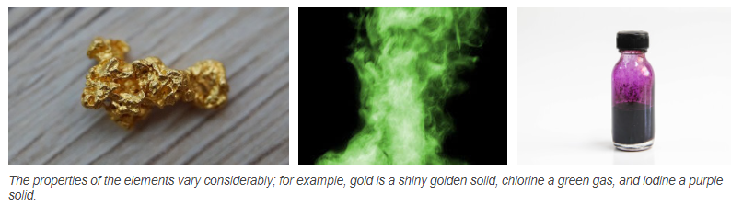
Atoms with the same numbers of protons, neutrons and electrons as each other are atoms of the same element.
Different elements have different numbers of subatomic particles from each other, and this gives them different chemical properties. The subatomic particles on their own do not possess the chemical properties of elements; these only emerge when they are combined in atoms.
The number of protons in an atom is called its atomic number. The number of protons is equal to the number of electrons in a neutral atom. The periodic table is arranged in order of atomic number, and patterns in the periodic table can tell you about the chemical and physical properties of the elements.

Slide 6
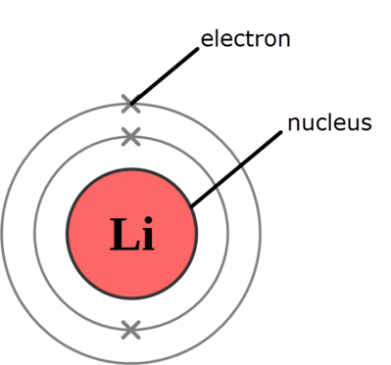
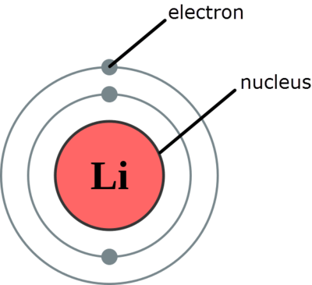
Electrons orbit the nucleus in a series of electron shells or orbitals.
Each electron shell has a different level of energy, and sits at a different distance from the nucleus. The lowest energy shell is closest to the nucleus, and the energy of the shells increases the further out from the nucleus they get.
In diagrams, the shells are usually represented as circles, and the electrons as dots or crosses.

Slide 7
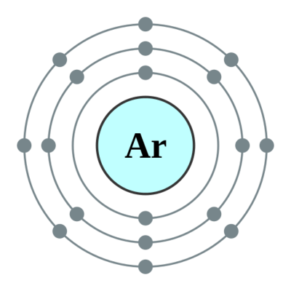
Each electron shell can only hold a certain number of electrons.
The first electron shell (the one closest to the nucleus, with the lowest energy) can hold up to 2 electrons.
The second shell can hold up to 8 electrons.
The third shell can hold up to 18 electrons, but it is stable with 8.
At this stage, you will not need to deal with more than 8 valence electrons. You may assume that the third shell is always stable with 8 electrons, and treat this as its limit.
An atom of argon, with 18 electrons, has all of the first three electron shells stable.

Slide 8
Electrons fill the shells starting from the first, lowest energy shell.
A hydrogen atom, with only 1 electron, cannot fill even the first shell. A helium atom, with 2 electrons, can fill the first shell. A lithium atom, with 3 electrons, starts to fill the second shell; its electron configuration is denoted as 2,1.
The electron arrangement in a calcium atom with 20 electrons as it fills its electron shells is shown below. Its electron configuration is 2,8,8,2.

Slide 9
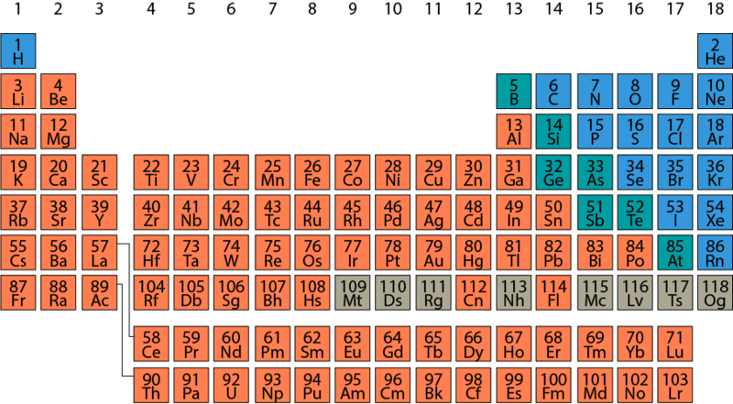
Electron Shells and the Periodic Table
An element’s atomic number can tell you how many electrons it has, and therefore how its electron shells are arranged. If you do this with a number of different elements, you’ll start to notice patterns.
Group 1, at the far left, all have a single electron in their outermost electron shell. The rightmost group in the periodic table (group 18, known as the noble or inert gases) have their outermost electron shell filled. The other groups range between these in predictable patterns.
These patterns will help you determine atoms’ electron configurations, but they also have a deeper significance, that we will learn about later in this lesson.

Slide 10
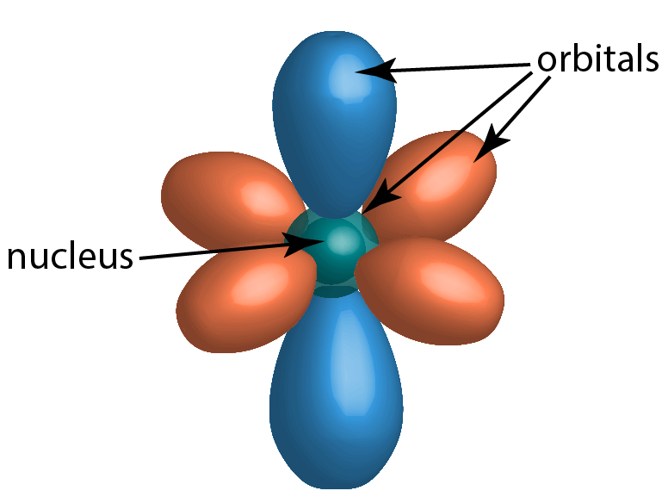
Scientific Models and Atomic Structure
A scientific model is a representation or way of thinking about something that is useful to explain and predict how it works. Some models are very complex, while some are quite simple. Some models reflect all of the scientific knowledge that we have available, while others are deliberately simplified to make them easier to use. We don’t know everything about how atoms work, because things that are so small are very difficult to study.
Electrons do not orbit the nucleus tidily, like planets around a star. They move in complex patterns that we can only really describe with probability. But the model we use depicting electrons in spherical shells around the nucleus is a useful scientific model.

Slide 11


Slide 12
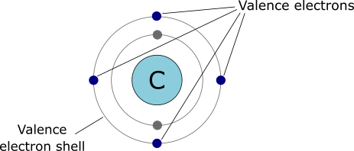
The outermost electron shell that is occupied by electrons is called the valence shell.
This is the shell that’s furthest from the nucleus of the atom, and has the highest energy. Depending on the atom’s total number of electrons, the valence shell is often not full.
Unlike the inner electron shells (the core shells), the electrons of the valence shell are able to interact directly with things outside the atom. This means that it is the valence electrons that are involved in chemical reactions.

Slide 13

An atom is most stable when it has a full valence shell.
The noble gases, found in group 18 of the periodic table, are chemically unreactive because their valence shells are already full.
Atoms without full valence shells will gain, lose, or share their valence electrons to become stable. This is the basis of chemical bonding.

Slide 14
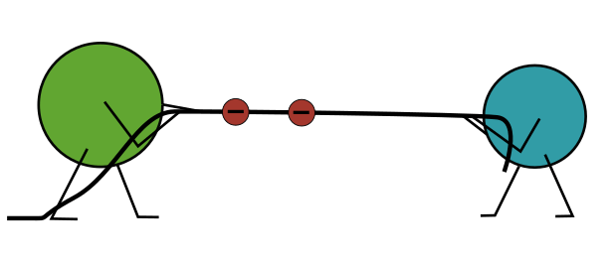
An atom will gain or lose electrons depending on how many electrons there are in the valence shell.
If the valence shell is close to full, it takes less energy to gain a small number of electrons than to lose the larger number already there.
When an atom gains electrons, it obtains extra negative charge which is not balanced by the protons in the nucleus. It becomes a negative ion, called an anion.
If the valence shell has few electrons in it, it takes less energy to lose a small number of electrons than to gain a large number.
When an atom loses electrons, it loses some of its negative charge, so the positive charge of the protons in the nucleus are no longer balanced by its electrons. It becomes a positive ion, called a cation.

Slide 15
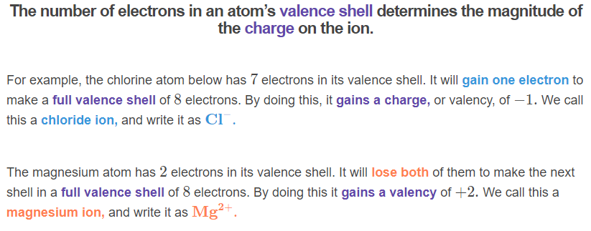
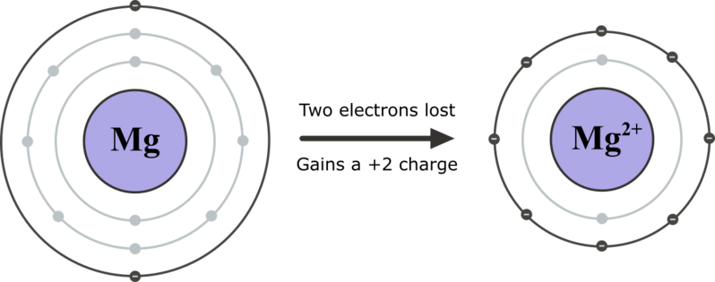
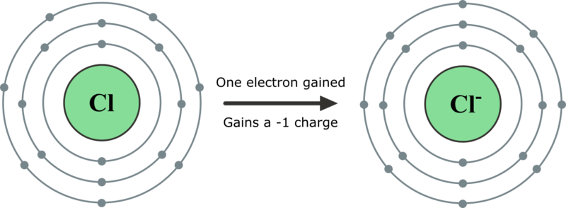

Slide 16
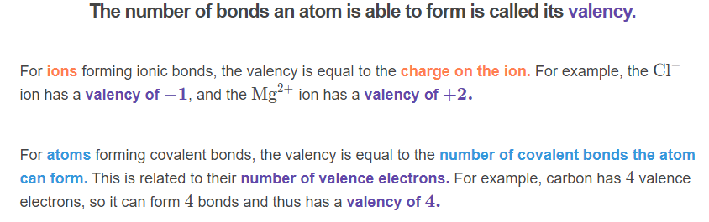
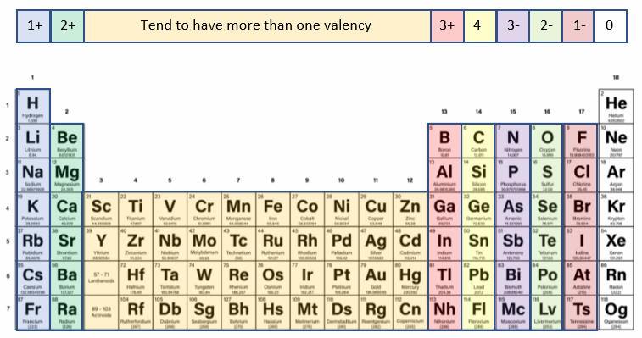

Slide 17
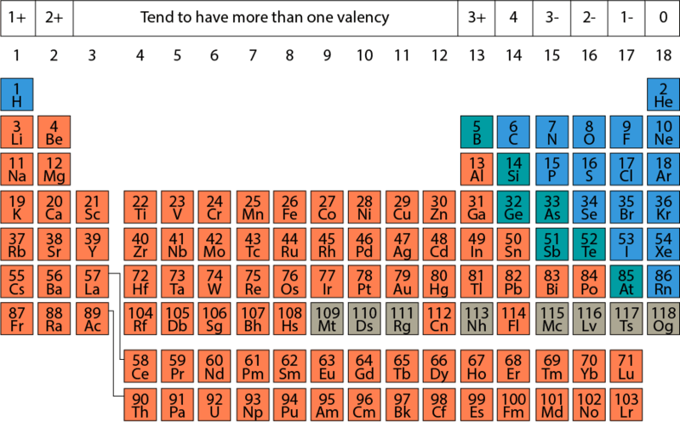
Chemical Properties and the Periodic Table
Elements with the same number of valence electrons tend to have similar chemical properties, because they must react in similar ways to obtain a full valence shell.
Generally, metal atoms, to the left and bottom of the periodic table, have low numbers of valence electrons, so they tend to lose electrons to form cations. Non-metal atoms, to the right of the periodic table, have high numbers of valence electrons, so they tend to gain electrons to form anions.
The number of valence electrons is the group number in the periodic table, or the group number −10 for higher numbered groups.

Slide 18
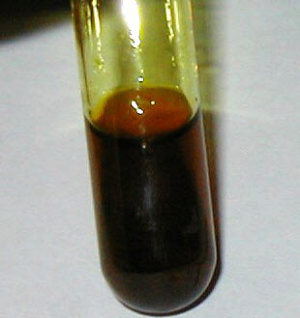
We seldom find free atoms in nature, because in order to lose, gain, or share electrons and achieve stability, they will bond with other atoms.
Spontaneous changes occur in nature to reach greater stability, and bonding is one such process. When compatible atoms collide with one another, they form chemical bonds. Energy is released when bonds form, which puts the newly bonded atoms into a lower energy, more stable state.
Chemical bonds may form molecules of a few atoms or larger compounds of a few million atoms. Only noble gases commonly exist as free atoms. For the rest, how they bond and what they bond with determines the properties of everything you see around you.

Slide 19
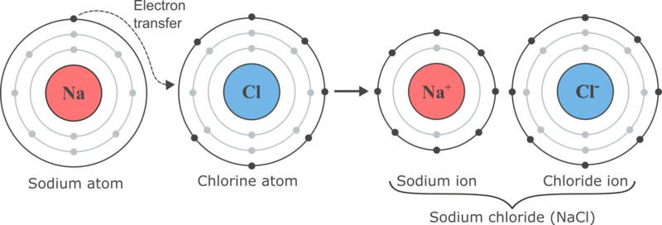
Ionic bonds occur when an atom which needs to lose electrons donates its valence electrons to an atom which needs to gain electrons.
This creates a pair of ions (a cation and an anion) which are attracted to each other. This attraction results in an ionic bond.
Ionic bonds usually form between a metal cation and a non-metal anion. Ionic bonds may form between many ions to create a lattice.

Slide 20
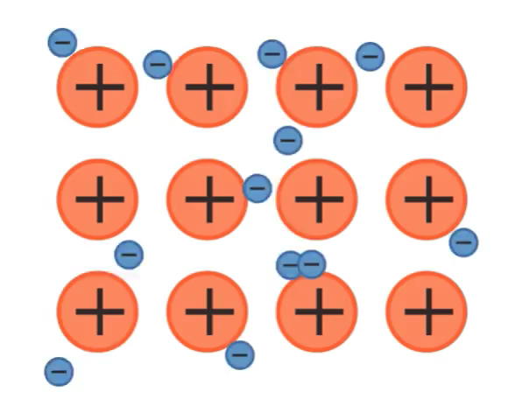
Atoms of metals can bond with each other by sharing electrons between many atoms.
In metallic bonding, the valence electrons of the metal atoms become delocalised, disconnecting from their nuclei. This results in a lattice of cations with a sea of delocalised electrons moving between them.
The electrons are attracted equally to all the metal cations, so they are free to move between them. The cations’ attractions to the electrons holds the cations in a lattice.

Slide 21
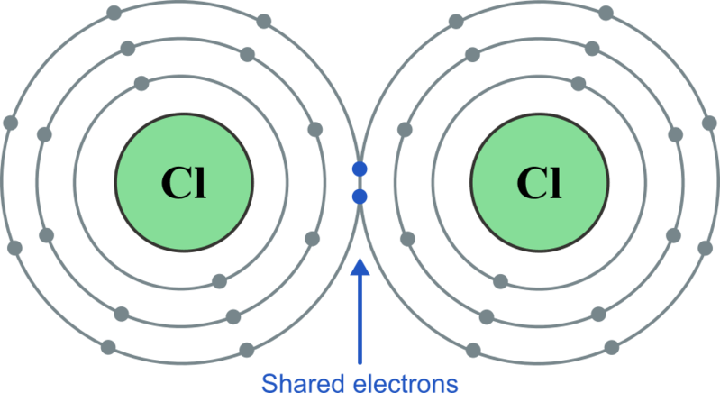
Covalent bonds occur when electrons are shared between nuclei.
In this situation, neither atom loses or gains an electron; instead, the shared electrons belong to both of them simultaneously. The outer electron shells of the atoms overlap, and the shared electrons’ attraction to both atoms holds the molecule together.
An atom’s number of valence electrons determines how many covalent bonds it can form; in other words, covalent bonding is related to valency. Covalent bonds usually form between non-metal atoms. Covalent bonds may form between many atoms to create a network.

Slide 22
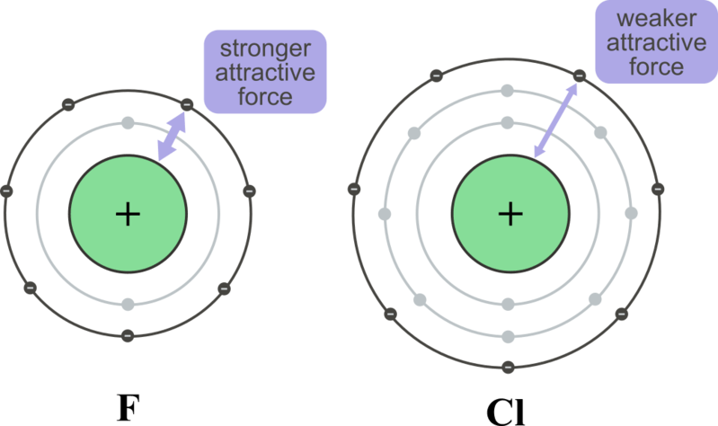
Different types of atoms do not attract electrons equally.
The strength with which an atom attracts electrons is called electronegativity. The electronegativity of an atom depends on a number of factors.
Elements with a greater number of protons in the nucleus will attract electrons more strongly due to their stronger positive charge. Elements which are smaller will attract electrons more strongly because there are fewer shells between the nucleus and its valence electrons and the outside world.

Slide 23
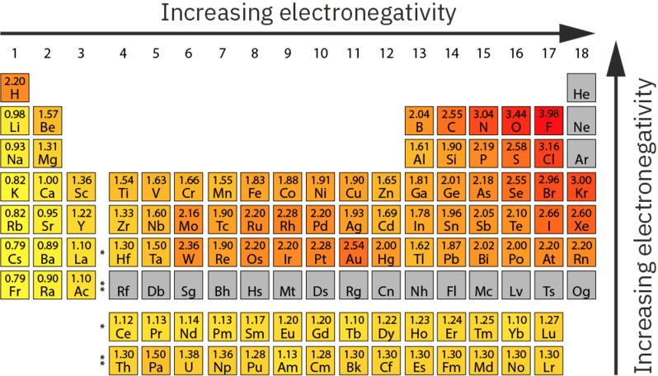
Electronegativity and the Periodic Table
These factors combine to mean that electronegativity generally increases from left to right and bottom to top of the periodic table.
Metallic elements have low electronegativities and non-metallic elements have high electronegativities - which is another way of saying that metal atoms tend to lose electrons and non-metallic atoms tend to gain them.

Slide 24
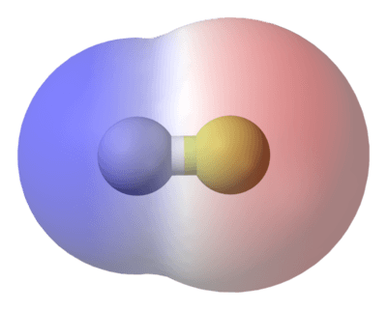
Varying electronegativity means that in most bonds, electrons will be more strongly attracted to one atom than the other.
This is the reason that some atoms form ionic bonds and some form covalent bonds: ionic bonds have a much greater electronegativity difference. However, it also means that many covalent bonds are polar; the shared electrons are more strongly attracted to one atom than the other, so they spend more of their time close to the more electronegative atom.
There can thus be considered a continuum between non-polar covalent bonds, where electrons are equally shared, through polar covalent bonds, where electrons are unequally shared, to ionic bonds, where electrons are not shared.

Slide 25


The physical properties of molecules and compounds are determined by the types of particles involved and the types of attractions between them.
The attractions involved in chemical bonds are electrostatic forces: the attractive forces between electrically charged objects. Opposite charges attract each other strongly, while like charges repel each other. This is why chemical bonds are determined by the interactions between protons and electrons.
Ionic, metallic, and covalent compounds have different physical properties depending on how their electrons are arranged and how the attractive forces between their atoms, ions, protons and electrons operate.

